Slide 1
Pandas DataFrames

Slide 2
Indexing
Two main ways to index into a Pandas DataFrame:
Loc
Uses column/row labels to index into the table
Iloc
Uses column/row indices to index into the table

Slide 3
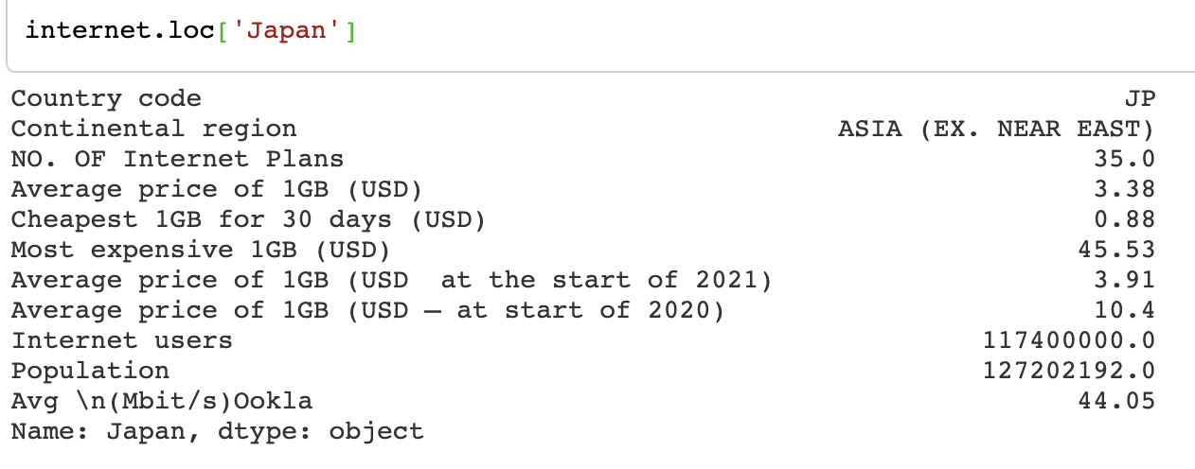
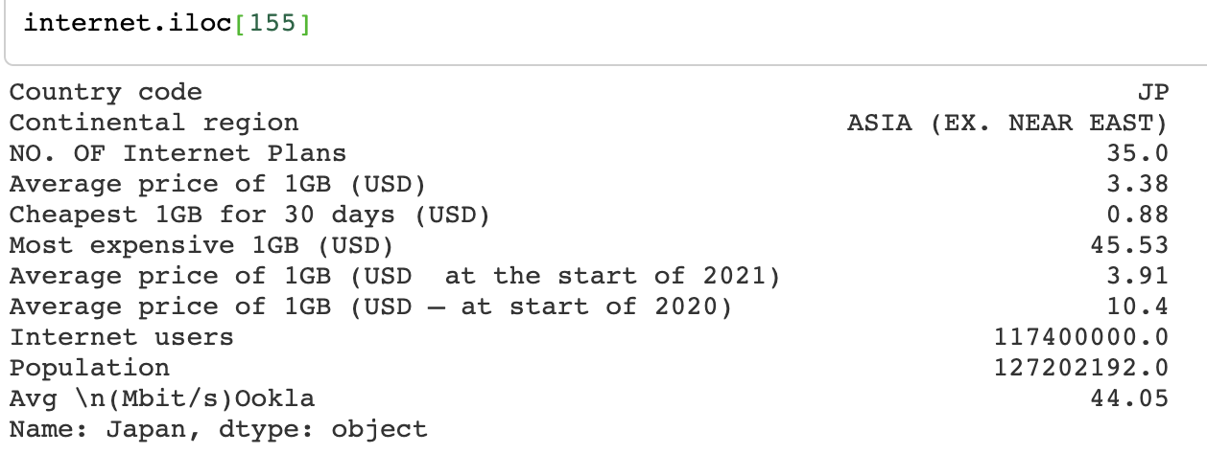
Indexing - Loc vs. Iloc example
loc
iloc

Slide 4
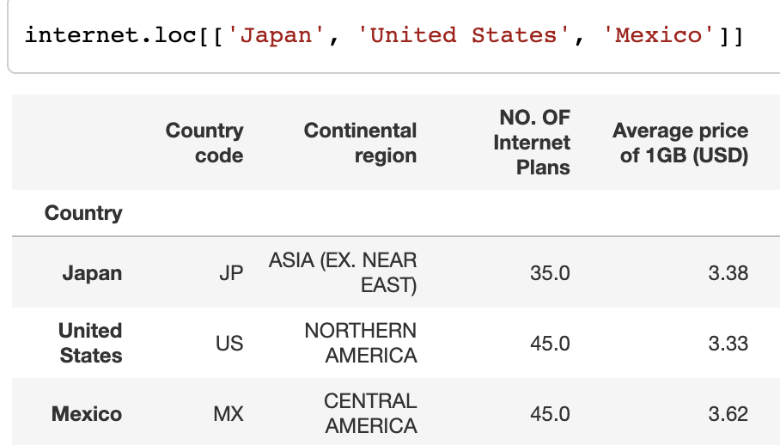
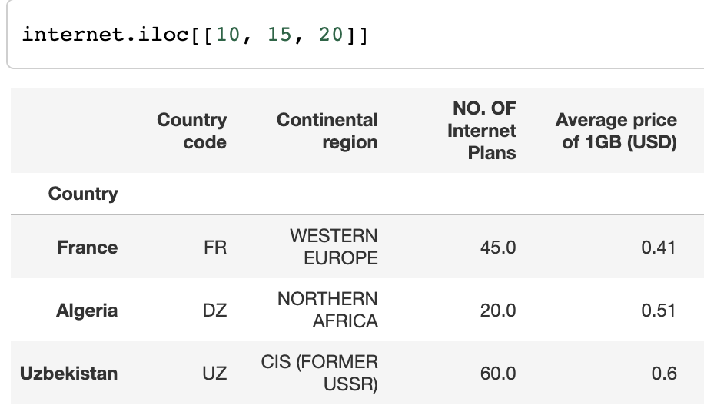
Getting multiple rows
Provide a list of labels:
Loc
.loc[[‘row label 1’, ‘row label 2’, ‘row label 3’]]
Iloc
.iloc[[index1, index2, index3]]

Slide 5
Slicing with iloc
Remember that iloc is exclusive for its stop index!
What rows would DataFrame.iloc[0:7:2] return?

Slide 6
Getting Columns
There are multiple ways to get columns from a dataframe:
Calling the column name (no loc/iloc):
internet[“Country code”]
Using loc (note that the column name(s) must be passed in as a list)
internet[:,[“Country code”]]
Using iloc
internet[:,0]
For loc and iloc, you need the ‘:’ to grab all the rows for the column(s) specified. You can also instead pass in the specific rows to grab!

Slide 7

In notebook 07_pandas-dataframes, complete the following section:
1.1 - Indexing & Slicing in Pandas
(Don’t forget to do the EDA before section 1.1 starts)

Slide 8
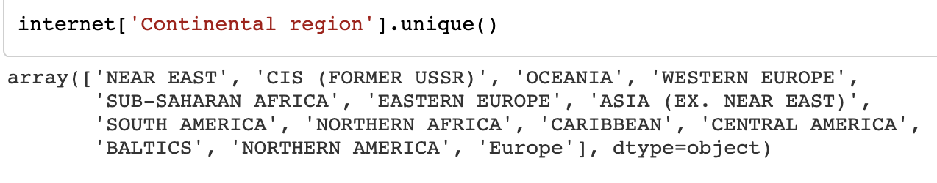
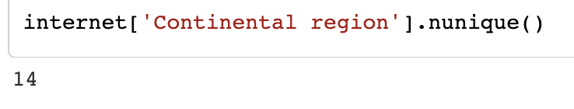
Uniqueness
Dataframe[“column name”].unique()
Returns the unique values
Dataframe[“column name”].nunique()
Returns number of unique values for a certain column

Slide 9
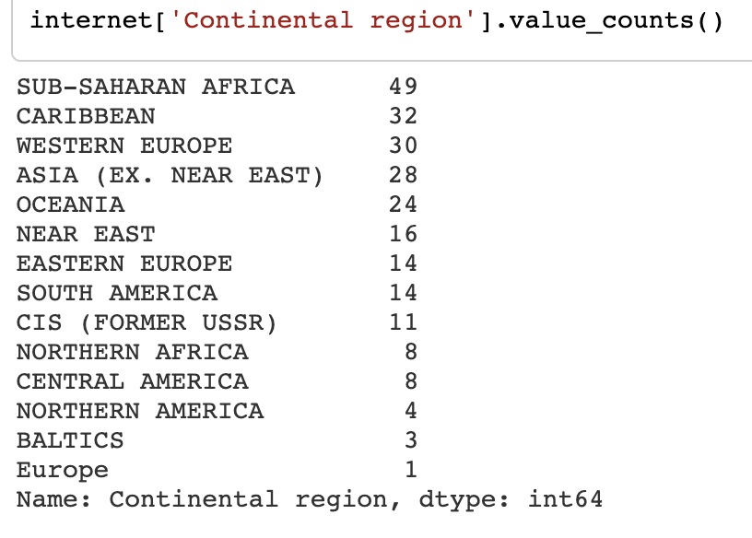
Frequencies
Dataframe[“column name”].value_counts()
Returns the counts for the unique values in our column

Slide 10
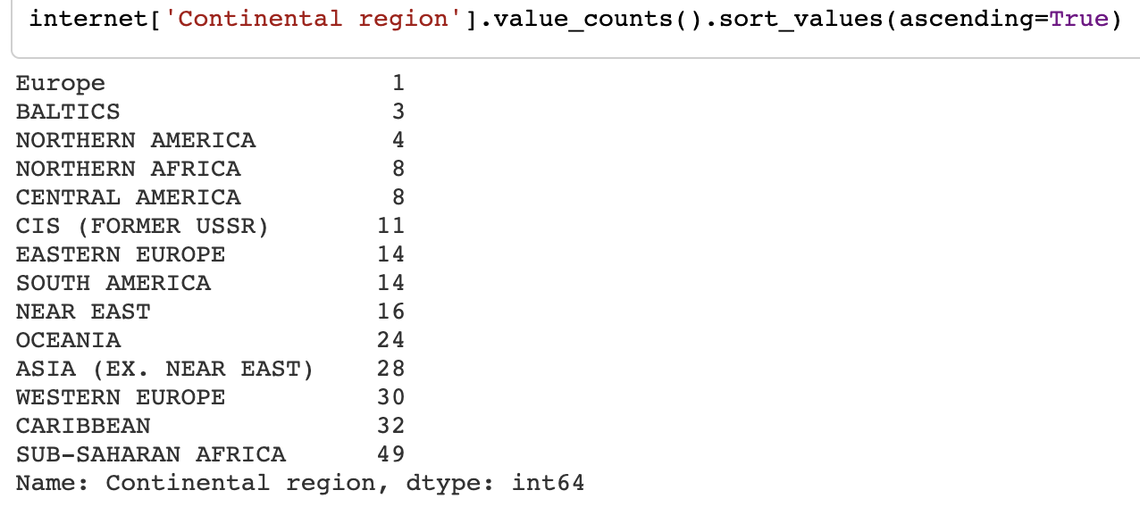
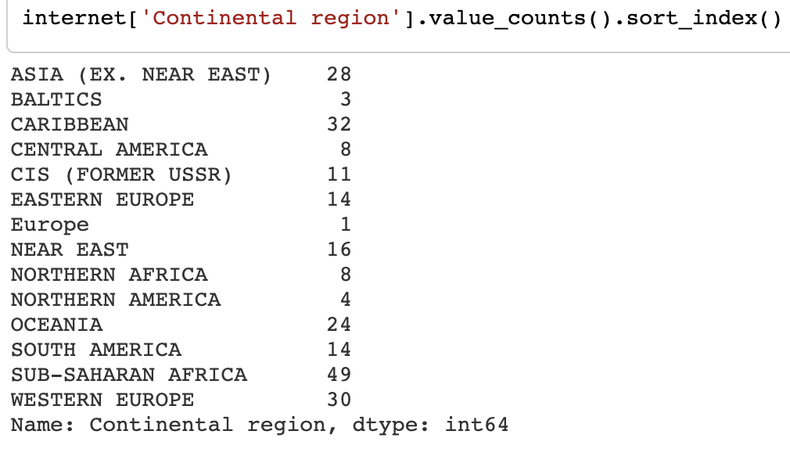
Sorting
Sort by counts by using .sort_values()
It will default to sort by smallest to largest. Use the argument ascending=False to sort by largest to smallest
Sort alphabetically by using .sort_index()

Slide 11
Finding Range - Min/Max
Finding min:
Dataframe[“column name”].min()
min(Dataframe[“column name”])
Any guesses on finding the max?
How would we then find range?

Slide 12
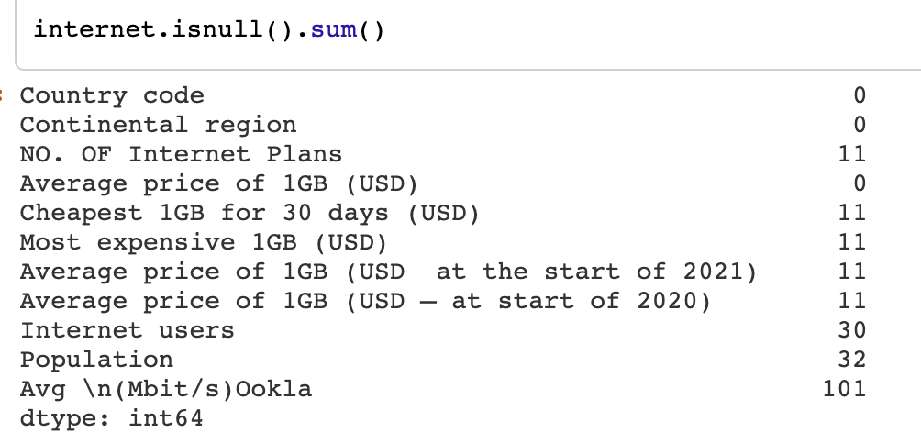
Null Values
Null values occur when there is no data for that specific datapoint
“NaN”
“Null”
Dataframe.isnull().sum()
Returns number of null values for each column
Dataframe[“column_name”].isnull().sum()
Returns number of null values for specified column
Why might values be null in a dataset??

Slide 13
In notebook 07_pandas-dataframes, complete the following sections:
1.2 - Uniqueness
1.3 - Frequencies
1.4 - Sorting
1.5 - Min, Max, Range
1.6 - Missing Values

Slide 14
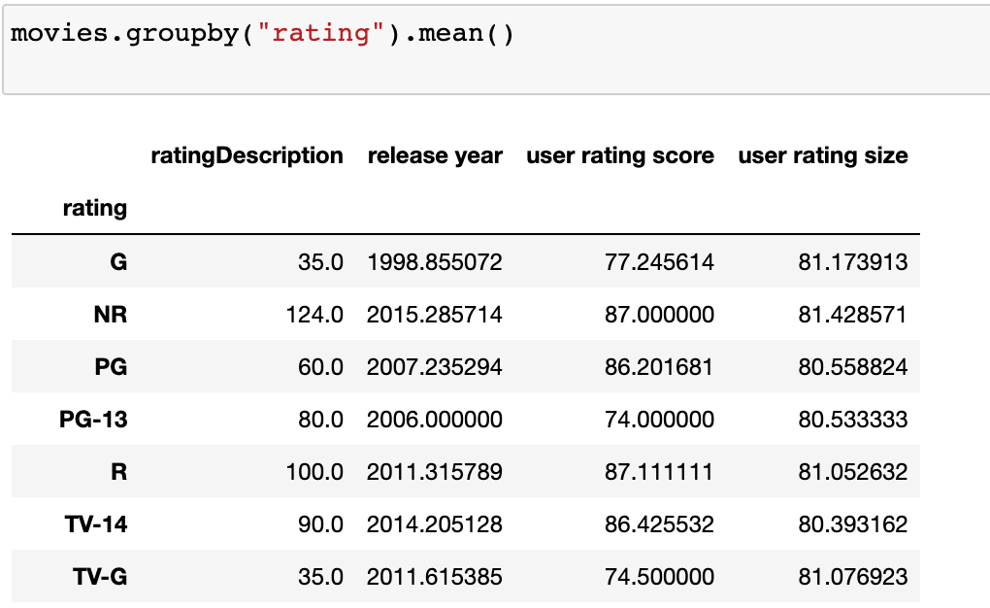
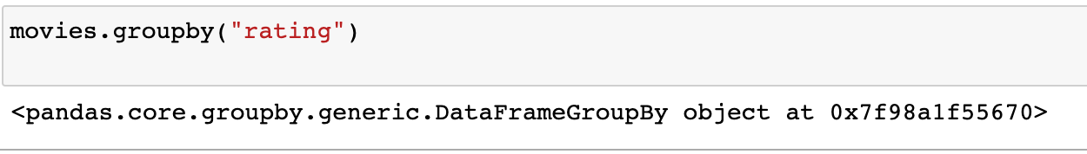
GroupBy
It can be really insightful to group a dataset by a certain column
For example, we could look at movies that were released in the same year, movies that have the same rating, …
When you group a table, you must choose a function to apply your grouping by
Functions include: count, mean, sum, max, etc.
NOTICE: when you do not use a function, there is no output

Slide 15
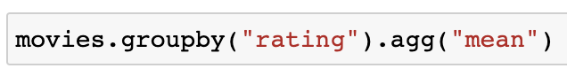
GroupBy
Two ways to call groupby:
Writing the function after groupby
Writing .agg() after groupby and writing the function within the parentheses (as a string)

Slide 16
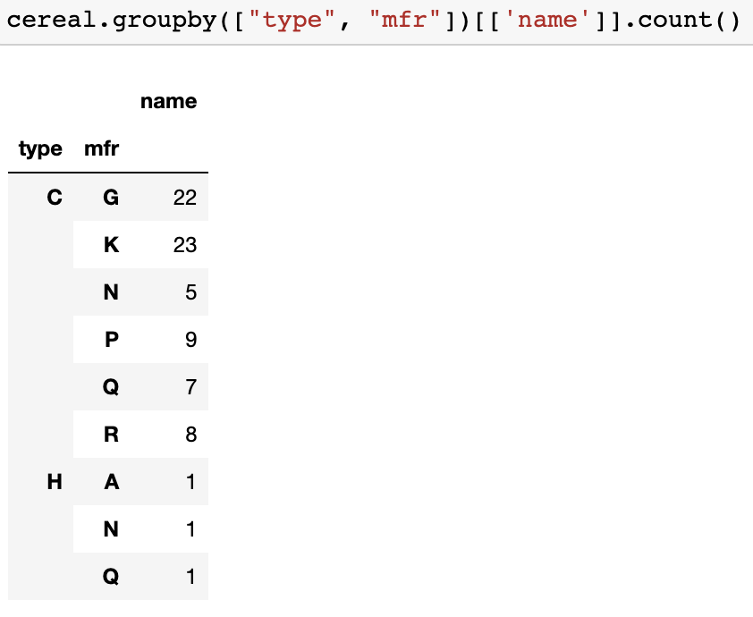
GroupBy
You can also group by multiple columns. Make sure the multiple columns are passed in as a list
Notice the list of columns!

Slide 17

Practice time!
Section 1.7 (GroupBy)

Slide 18
Boolean Indexing
Review: What are the two types of boolean values?
Boolean indexing lets you access a subset of the data that meets a certain condition.
Often people refer to boolean indexing as filtering data

Slide 19
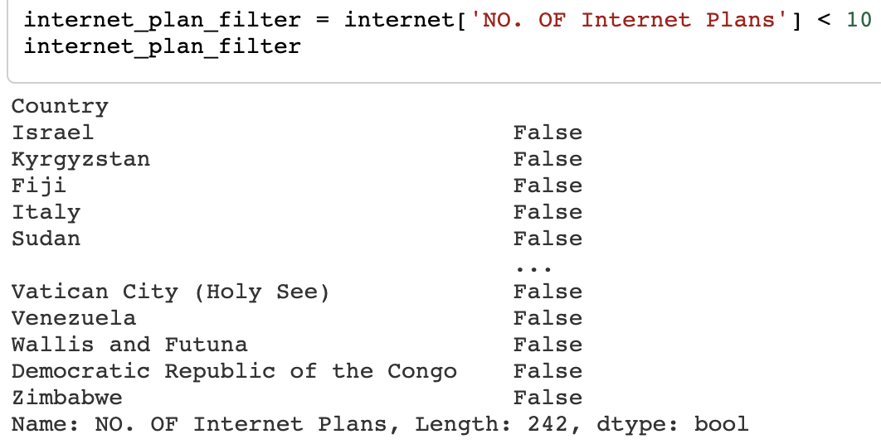
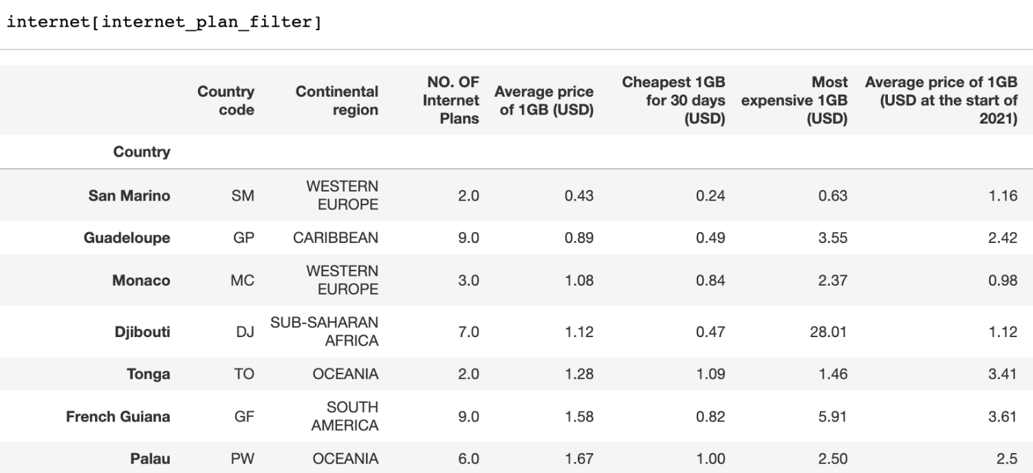
Boolean Indexing - Example
What condition does the following filter follow?
You can pass the filter into the dataframe to get just the data that follows the filter’s condition:

Slide 20
Boolean Indexing - Example
Challenge: Is there a way to accomplish this with just one line of code?

Slide 21
Boolean Indexing - Multiple Conditions
And (&)
Returns only rows where both conditions are met
Example: dataframe[(dataframe[“column name”] == this) & (dataframe[“column name”] < 20)]
Or (|)
Returns rows where either conditions are met
Example: dataframe[(dataframe[“column name”] == this) | (dataframe[“column name”] < 20)]

Slide 22
Boolean Indexing - Multiple Conditions
Example:
You filter the internet dataframe in two different ways:
internet[(internet[“Continental region”] == “South America”) & (internet[“NO. Of Internet Plans”] > 30)]
internet[(internet[“Continental region”] == “South America”) | (internet[“NO. Of Internet Plans”] > 30)]
Which dataframe will have more rows? Why?

Slide 23
In notebook 07_pandas-dataframes complete the following section:
2 - Booleans & Boolean Indexing
When you are done, complete the Exit Ticket!

